Slide 1
Publication of thesis
06/05-2026
Agenda
Catch up: What was the topic of the thesis? # 10 minutes
RQs and methods
Potential article storylines # 15 minutes
Planning next meeting # 2 minutes

Slide 2
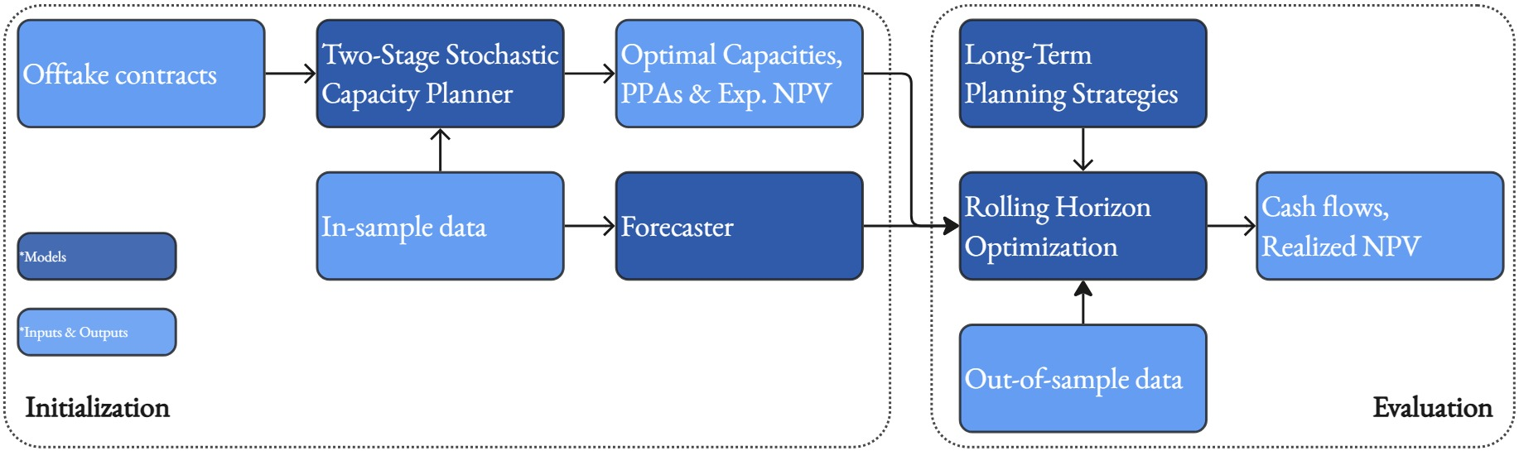
Article Storyline

Slide 3
Research questions
How can long-term contractual offtake commitments be optimally navigated in daily operational planning of renewable fuel production?
How do long-term offtake contracts impact the ability to capture favourable electricity prices in the day-ahead electricity market?
Notes:
Discuss pros and cons of the LTPS
The forecaster

Slide 4
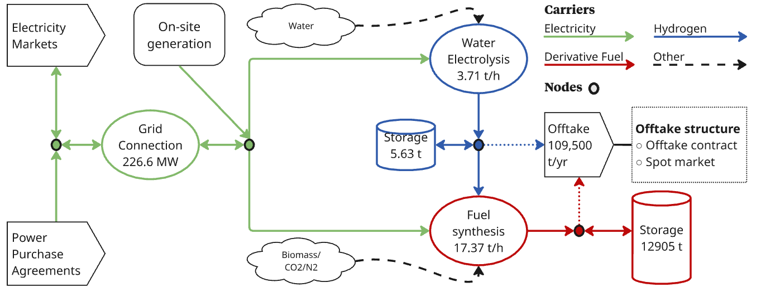
Optimal capacities based on 4 years of data

Slide 5
Thesis summary
Main RQ
How can long-term contractual offtake commitments be effectively integrated into the daily operational planning of a renewable fuel plant?
Key findings
The opportunity cost of electricity sales under long-term offtake contracts can be accurately estimated using a production-weighted price duration curve.
Day-ahead market participation strategies have been formulated and tested – Obtaining up to 95.3% of optimal profits across a year (with no foresight capabilities).
Obtaining a good estimate of a strike price for the fuel production makes the market participation strategy straightforward and robust against poor short-term forecasting capabilities.
Methods
Rolling horizon optimization
Price duration curves used to identify ópportunity costs.
Bidding strategies: Linear decision rules, stochastic LP-integrated bidding curve identification.

Slide 6
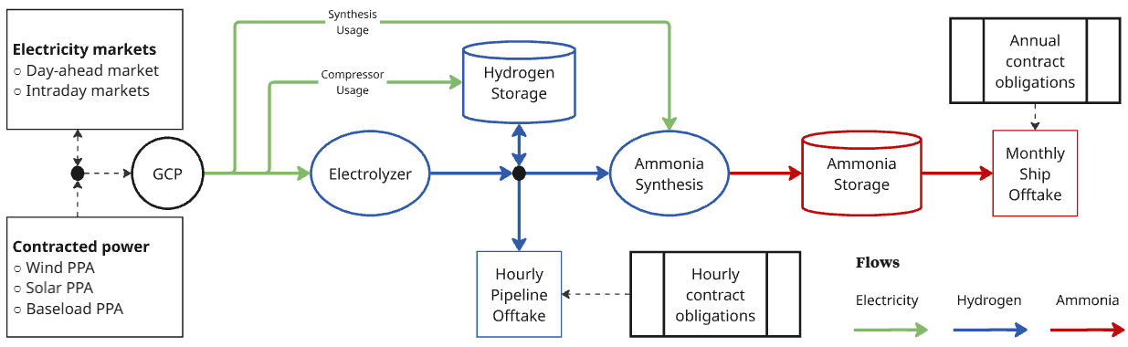
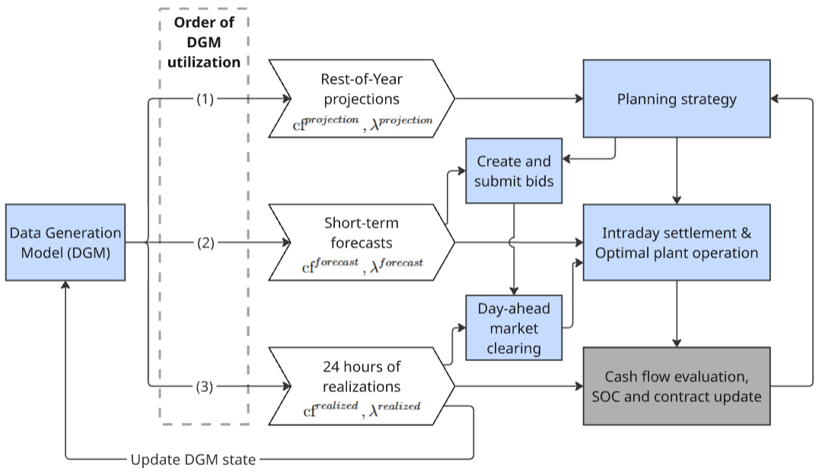
Case study
Portuguese H2 and NH3 synthesis plant. Large-scale, grid-connected.
Fully linear rolling horizon decision-making model - not modelling inflexible plant units.

Slide 7
Future work avenues – recent work
How does the methodology handle non-linearity and inflexibility of plant units?
Keeping the linear model formulation, I model non-linear efficiency curves of the electrolyzer and the ammonia synthesis unit.
What is the dependency on accurate assessment of long-term price trends?
Instead of simulating the realizations using the DGM, I now also backcast on the 8 years from 2017 to 2024, testing the combined performance of forecast capabilities and decision-making method.
Better alternative strategies other than perfect foresight and fixed hourly production.
Aggregate model and receding horizon model proposed and tested.

Slide 8
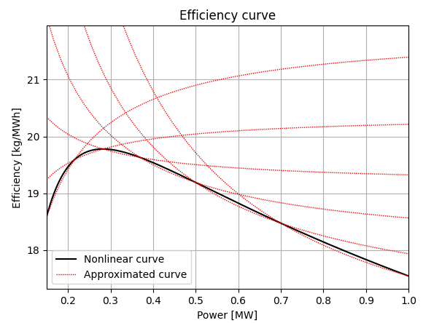
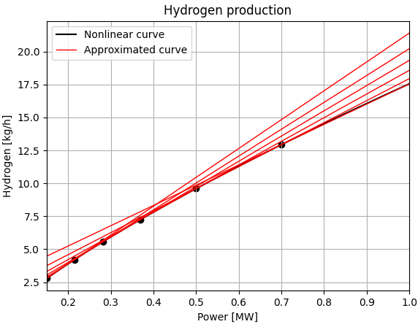
Non-linear efficiency curves
Alkaline Electrolyzer
Haber Bosch Unit

Slide 9
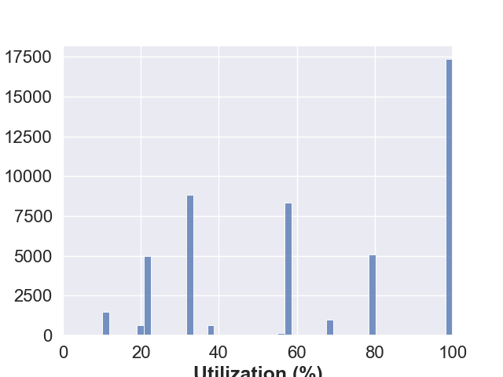
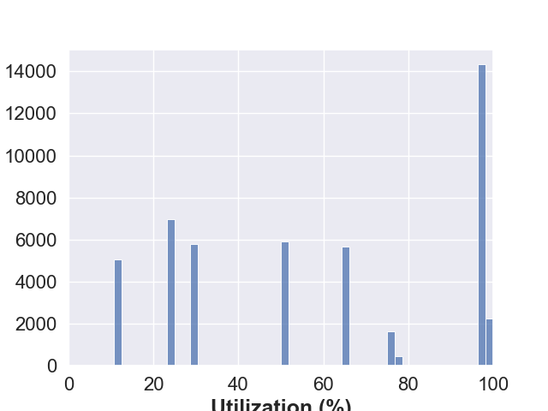
Non-linear efficiency curves
Alkaline Electrolyzer
Haber Bosch Unit

Slide 10
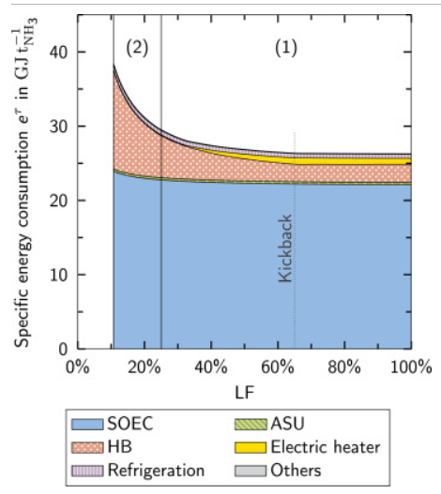
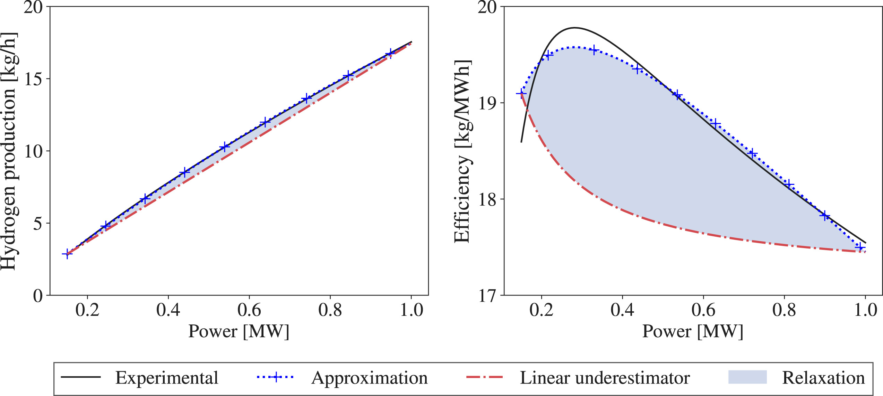
Non-linear efficiency curves - sources
Alkaline Electrolyzer
A conic model for electrolyzer scheduling
Haber Bosch Unit
Heat integration and part-load performance of an SOEC-coupled Haber–Bosch process

Slide 11
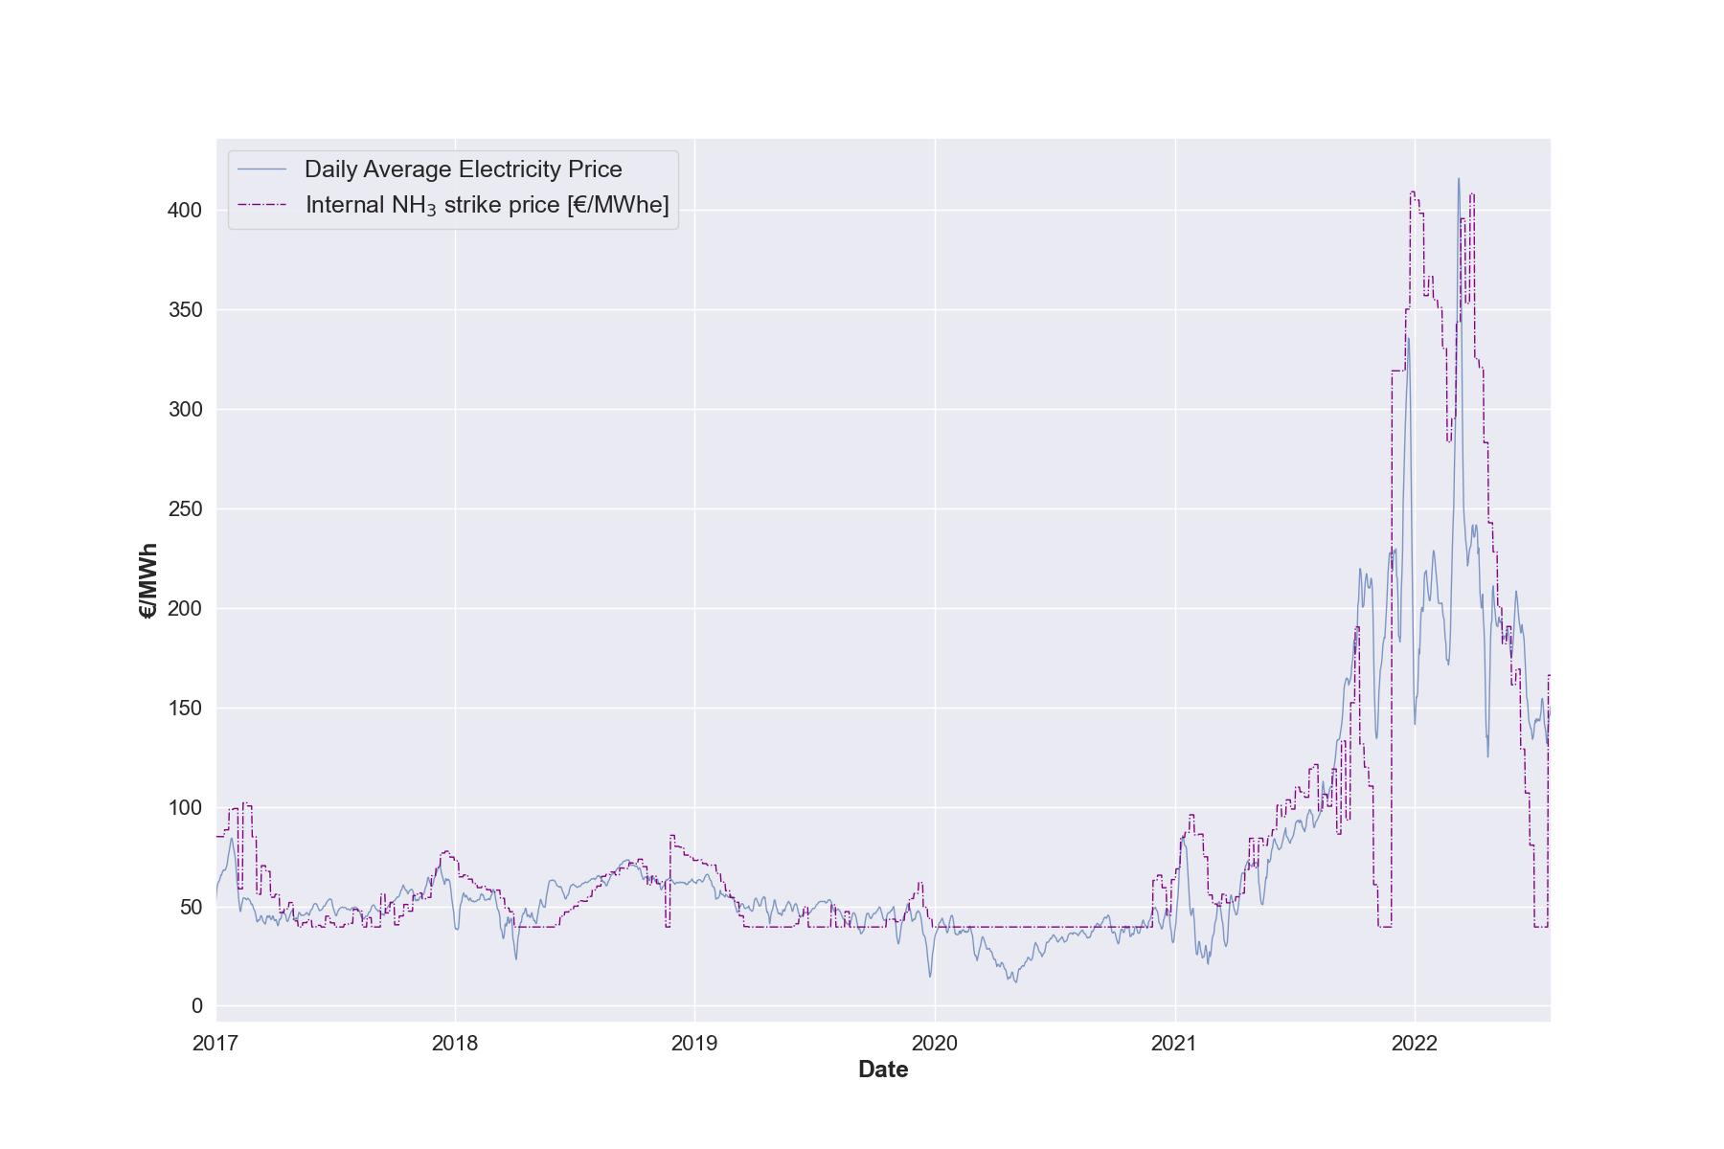
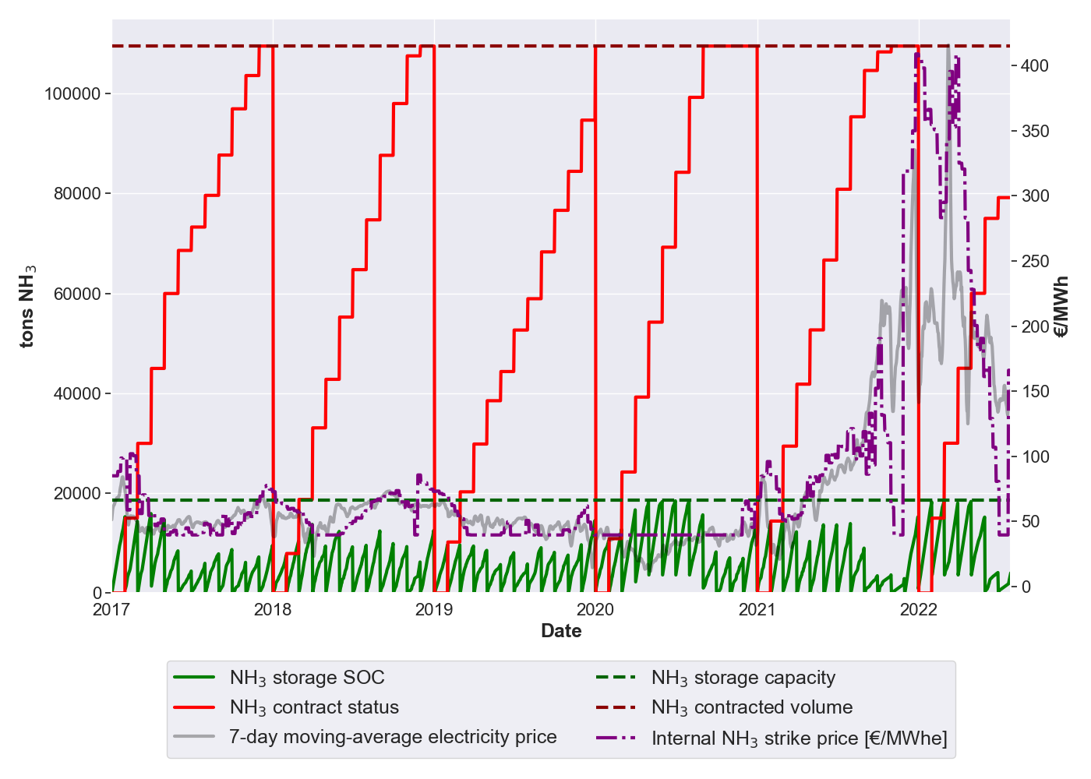
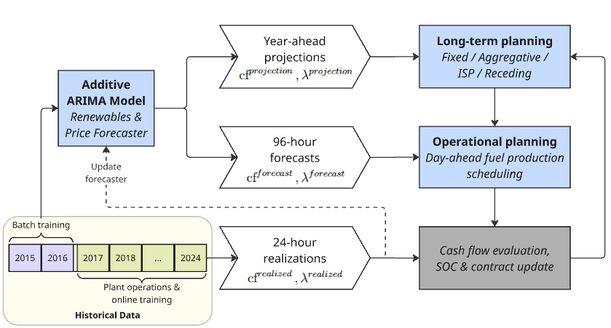
Backcasting
13 month long-term horizon – can be aware of the coming year ahead of time.
Showcases the effects of real market disruptions on the ability to operate optimally.
Preliminary run:

Slide 12
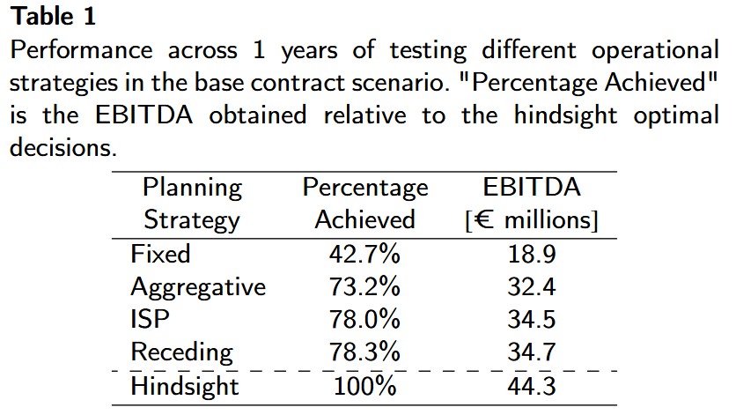
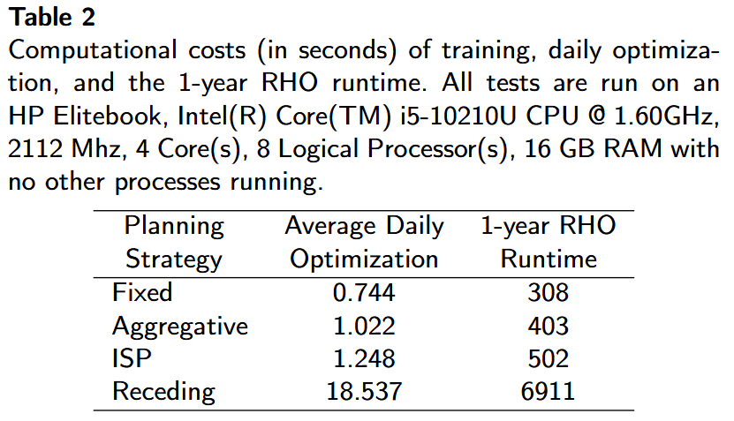
Better benchmarks
Receding horizon: Make a large model every day including all time steps in the year-ahead problem. Slow put precise.
Aggregate horizon: Create 1 extra time step (after the 96 hour planning horizon) which aggregates the remaining ~8000 hours of flows and trade.
Notes:
Computatinal costs: Write solver and algebraic language: (implementation (Pyomo, python)).

Slide 13
Focus of article
The opportunity cost of electricity sales - navigating offtake contracts in renewable fuel production planning
Focusing on the ISP methodology.
Decision support for contracted renewable fuel production - contract structures and risk profiles
Focusing on a decision support framework for identifying “optimal” offtake contract structure.
Other?

Slide 14
Target journal/conference
Energy Economics
Maybe most prolific/most difficult.
Applied Energy
Has published a lot of similar studies.
IAEE Munich
Opportunity. Abstract deadline tomorrow.

Slide 15
Next meeting(s)?
Work distribution
Etc.

